Slide 1
Module 9: Developing Custom Vision Solutions

Slide 2
Module Agenda
Image Classification
Object Detection

Slide 3
Lesson 1: Image Classification

Slide 4






The Custom Vision Service
Train custom models with your own images
Image classification
Object detection
Requires two kinds of resource:
Training Resource:
Cognitive Services
Custom Vision (Training)
Prediction Resource:
Cognitive Services
Custom Vision (Prediction)
Apple
Use your own images to train a model
Use the model to predict labels for new images

Slide 5
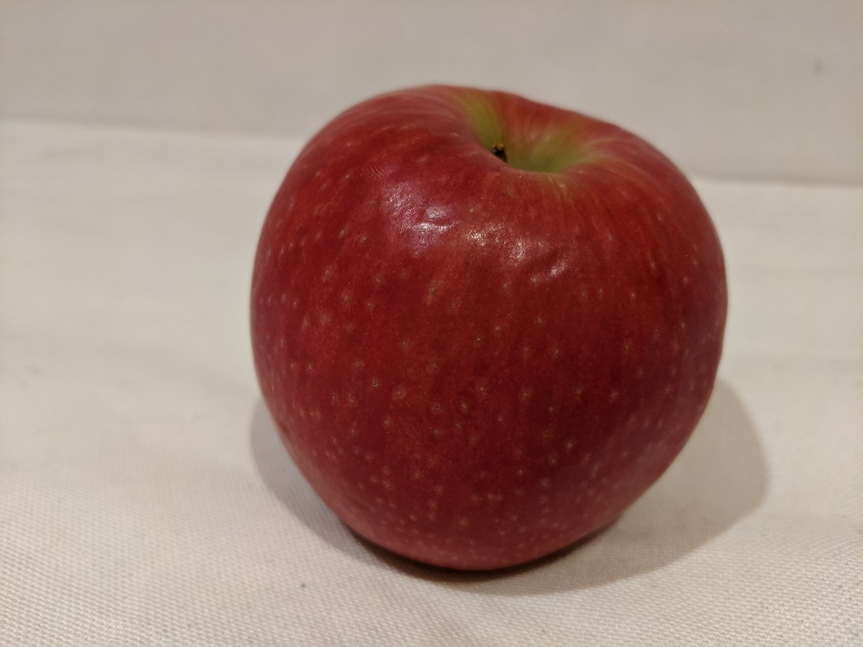
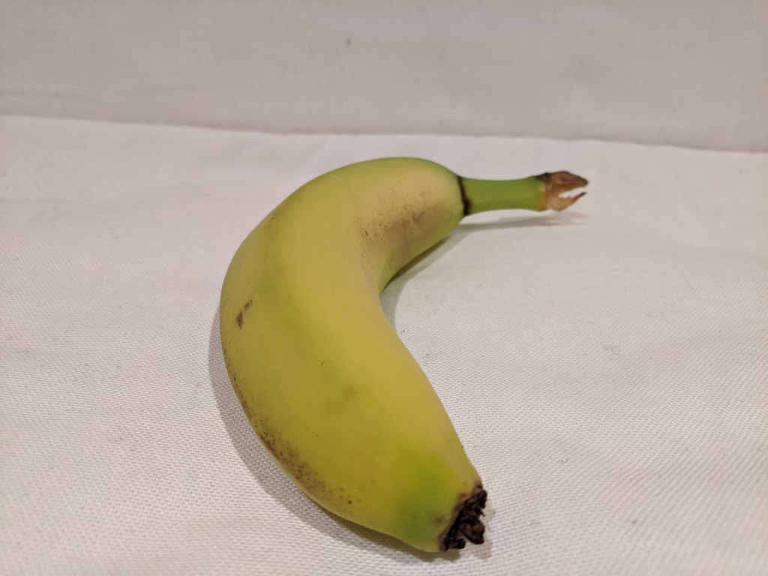
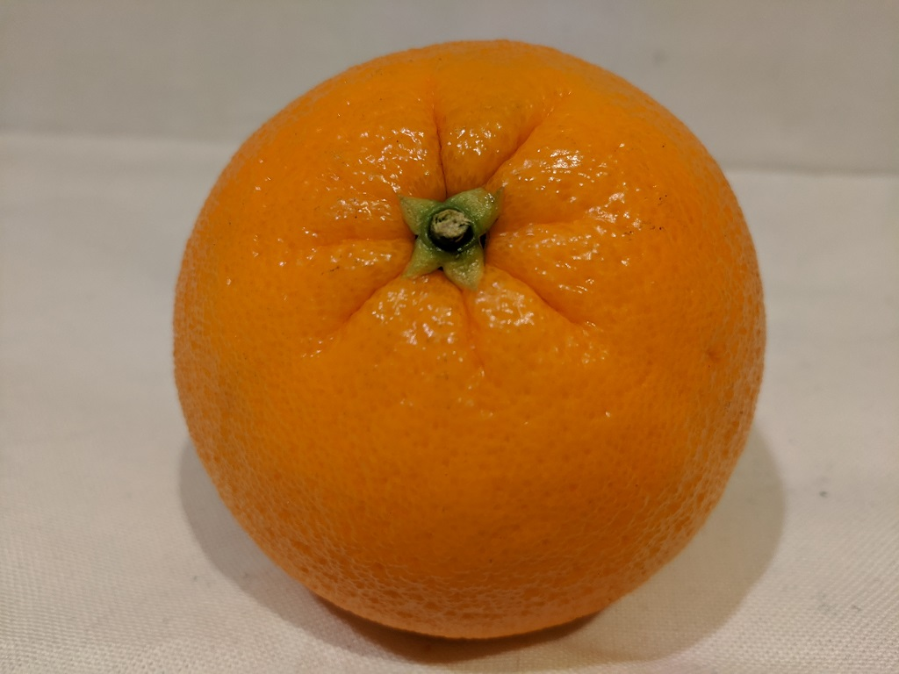
What is Image Classification?
Train a model to predict the class label for the image
In other words, what is this a picture of?
Apple
Banana
Orange

Slide 6
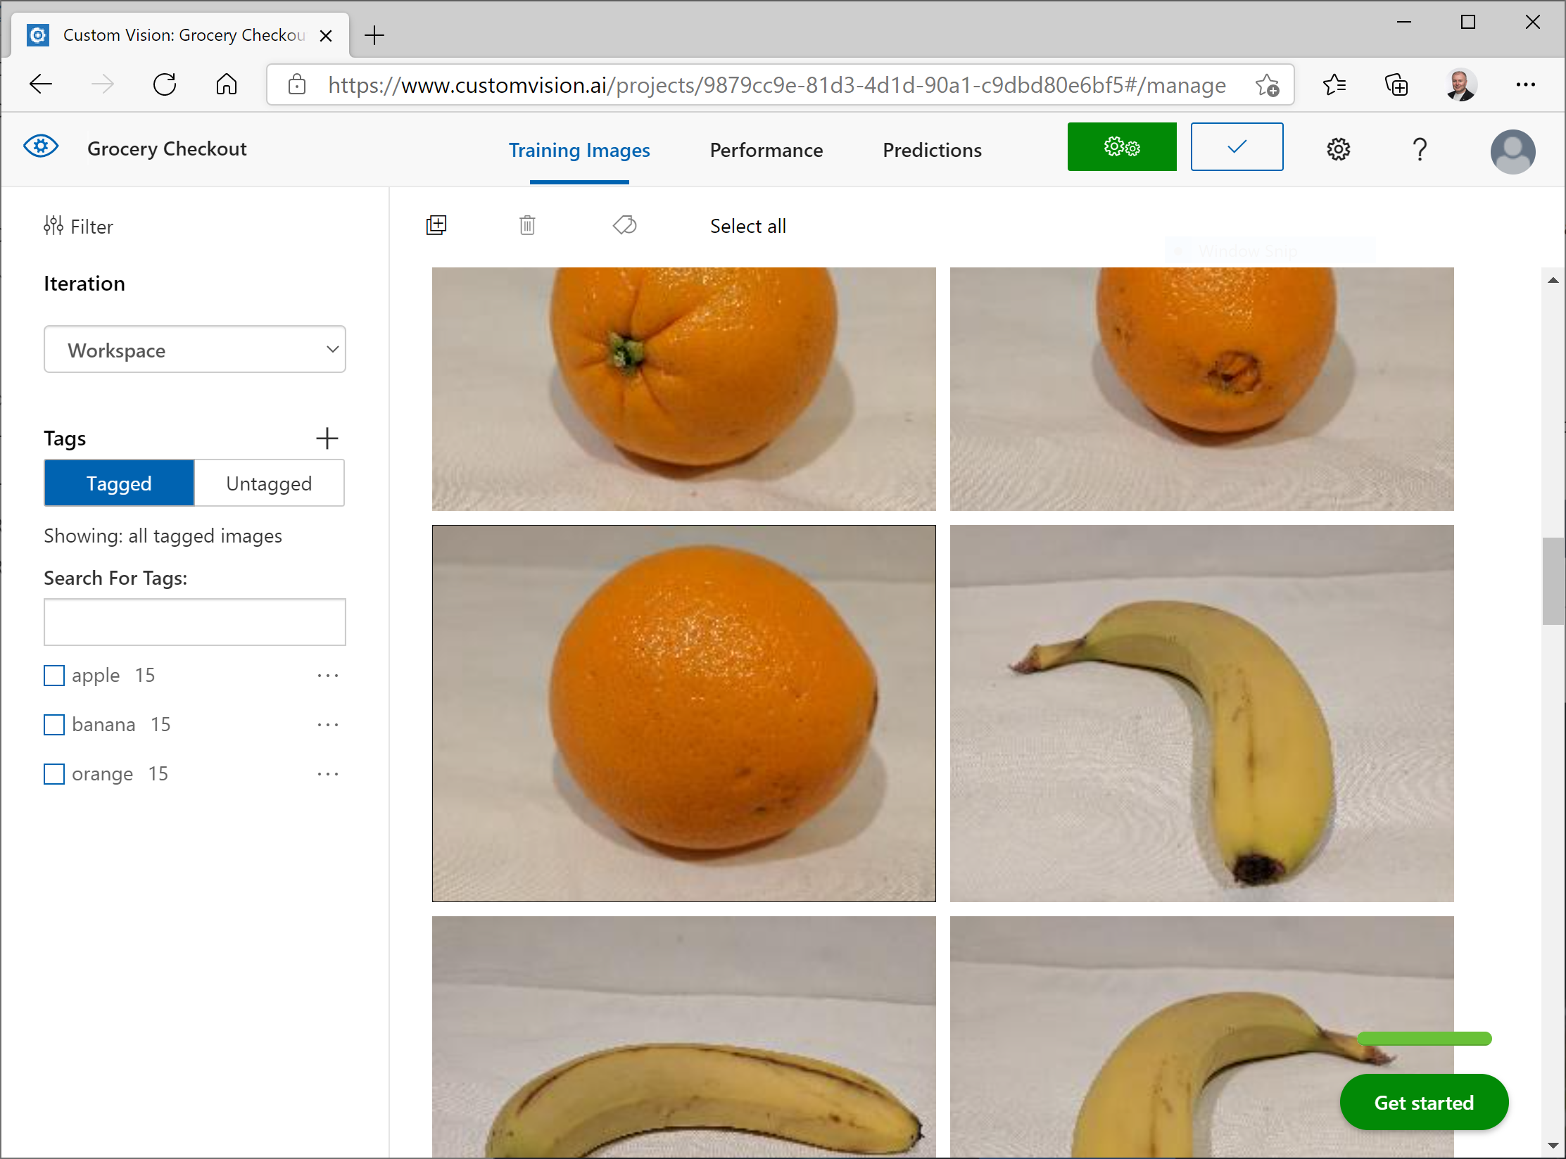
Training an Image Classifier
Use the Custom Vision Portal
Use the Custom Vision API / SDK
REST API or SDK for your preferred language
Create a project, or retrieve an existing one
Create or retrieve class tags
Upload tagged images
Train the model

Slide 7
Lab – Classify Images with Custom Vision
Create a classification model
Use the Custom Vision SDK with a training resource
Use the Custom Vision SDK with a prediction resource

Slide 8
Lesson 2: Object Detection

Slide 9
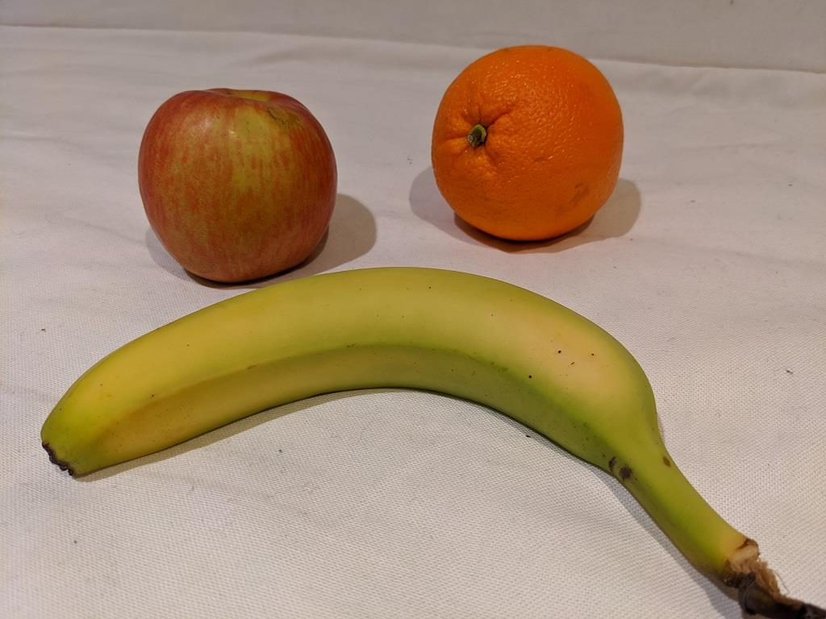
What is Object Detection?
Train a model to detect and locate specific classes of object in images
In other words, what objects are in this image, and where?
Orange
Apple
Banana

Slide 10
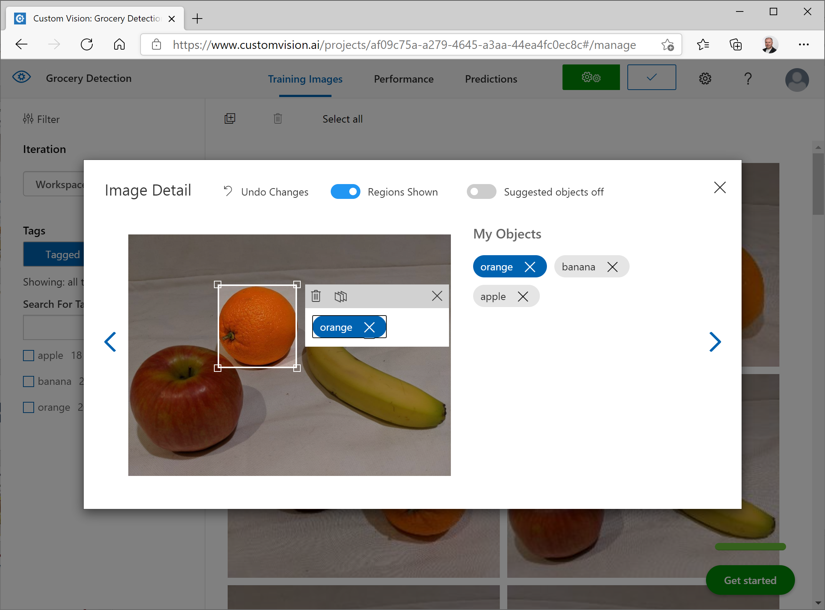
Training an Object Detector
Use the Custom Vision Portal
Use the Custom Vision API / SDK
REST API or SDK for your preferred language
Create a project, or retrieve an existing one
Create or retrieve class tags
For each image, create a list of regions (bounding boxes) with corresponding tags for the objects in the image
Upload tagged images
Train the model

Slide 11
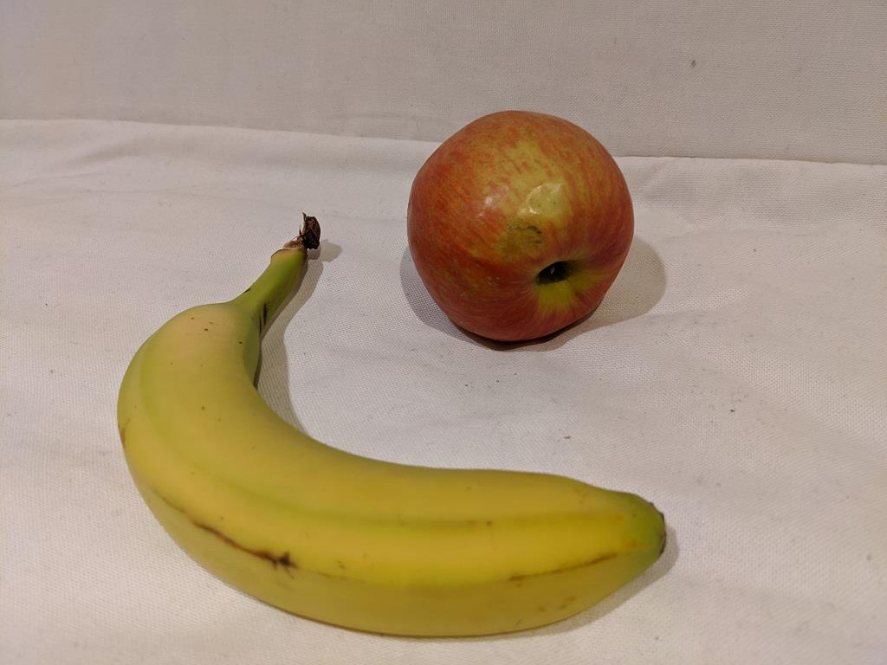
Labeling Images
Easiest option is to tag images interactively in the Custom Vision portal
The portal supports smart labeling, after an initial model is trained
Other tagging tools exist
Need to export in correct format for Custom Vision – coordinates and measurements are proportional to image size
"tags": [
{
"tag": "apple",
"left": 0.446089834,
"top": 0.158026949,
"width": 0.2905319,
"height": 0.368484139
},
{
"tag": "banana",
"left": 0.137872428,
"top": 0.3037218,
"width": 0.6171047,
"height": 0.6428385
}
]

Slide 12
Lab – Detect Objects in Images with Custom Vision
Create an object detection model
Use the Custom Vision SDK with a training resource
Use the Custom Vision SDK with a prediction resource
Notes:
Note: This lab is very similar to the previous one. If you are short on time, you may want to skip this lab or suggest students try it for themselves later.

Slide 13

Module Review
You want to train a model that can categorize an image as "cat" or "dog" based on its subject.
What kind of Custom Vision project should you create?
Image classification (multiclass)
Image classification (multilabel)
Object detection
Which of the following kinds of Azure resource can you use to host a trained Custom Vision model?
Custom Vision (Training)
Computer Vision
Cognitive Services
What must you do before taking advantage of the smart labeler tool when creating an object detection model?
Create a JSON file containing bounding box coordinates.
Tag some images with objects of each class and train an initial object detection model.
Train an image classification (multilabel) model.
Notes:
Use the slide animation to reveal the correct answers.

Slide 14
Closing slide

